Slide 1
超越自我
This template is exclusively designed by ... creative, and copyrights belong to 1ppt internet.
RESUME
自我介绍
姓名：第一PPT
邮箱：12345678@128.com

Slide 2
行业PPT模板http://www.1ppt.com/hangye/
超越自我
This template is exclusively designed by ... creative, and copyrights belong to 1ppt internet.
1/4
2/4
3/4
4/4
个人信息
工作履历
所获荣誉
规划展望
This template is exclusively designed by ... creative, and copyrights belong to 1ppt internet
This template is exclusively designed by ... creative, and copyrights belong to 1ppt internet
This template is exclusively designed by ... creative, and copyrights belong to 1ppt internet
This template is exclusively designed by ... creative, and copyrights belong to 1ppt internet

Slide 3
超越自我
This template is exclusively designed by ... creative, and copyrights belong to 1ppt internet.
个人信息
1/4

Slide 4

超越自我
This template is exclusively designed by ... creative, and copyrights belong to 1ppt internet.
姓名：第一PPT
This template is exclusively designed by ... creative, and copyrights belong to 1ppt internet.
毕业学校：第一PPT大学
专业：平面设计专业
年龄：1992年8月
星座：处女座
爱好：音乐、运动
政治面貌：中共党员
自我评价：性格开朗，工作认真负责，有很强的责任心和进取心，头脑灵活，能够很好的处理同事关心，具有强烈的团队合作精神

Slide 5
超越自我
This template is exclusively designed by ... creative, and copyrights belong to 1ppt internet.
标题文字添加
标题文字添加
The user can demonstrate on a projector or computer, or presentation and make it film to be used in a wider field
方法一
The user can demonstrate on a projector or computer, or presentation and make it film to be used in a wider field
方法二
01
02
方法三
标题文字添加
标题文字添加
The user can demonstrate on a projector or computer, or presentation and make it film to be used in a wider field
03
方法四
The user can demonstrate on a projector or computer, or presentation and make it film to be used in a wider field
04

Slide 6
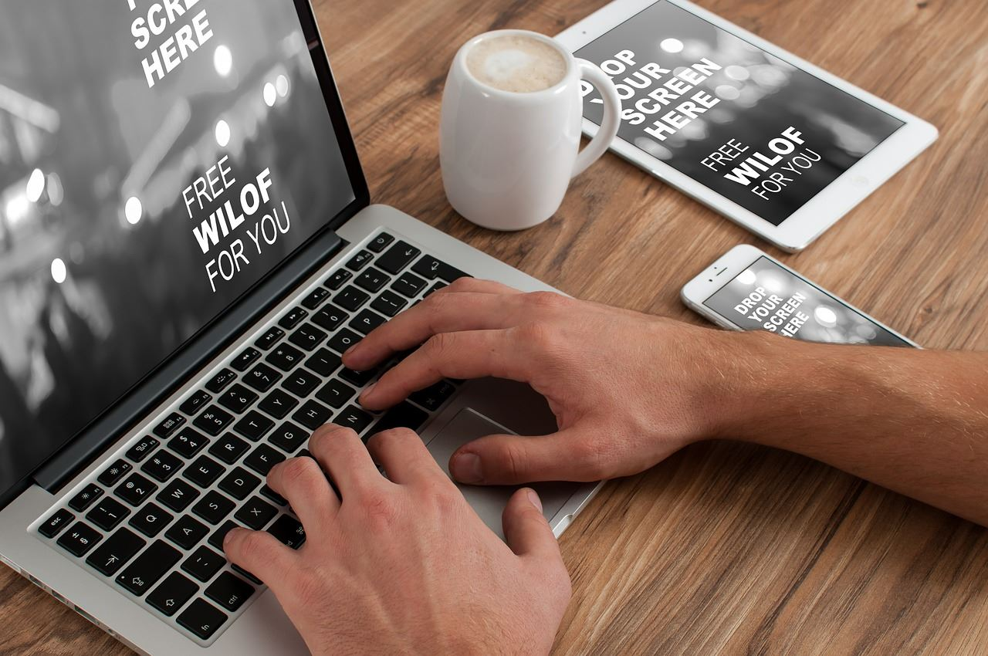
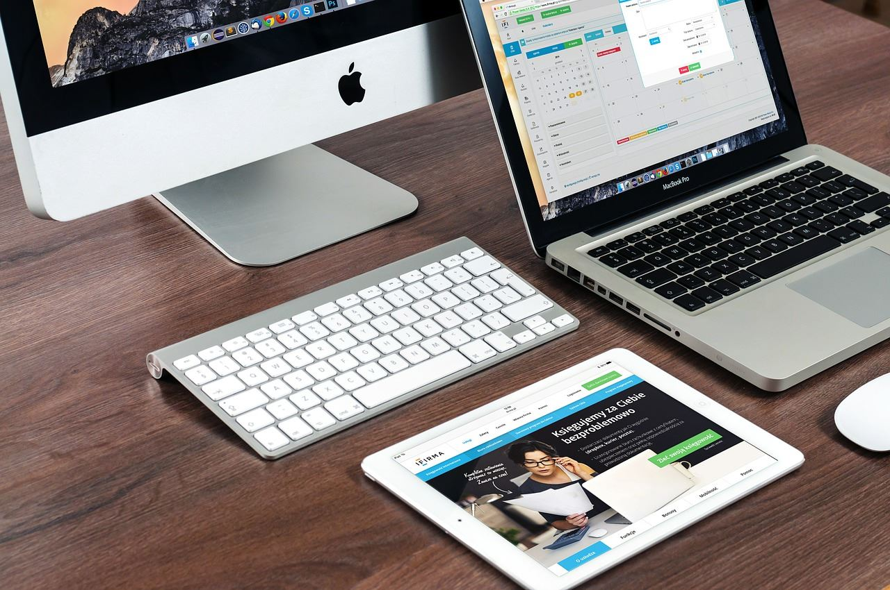
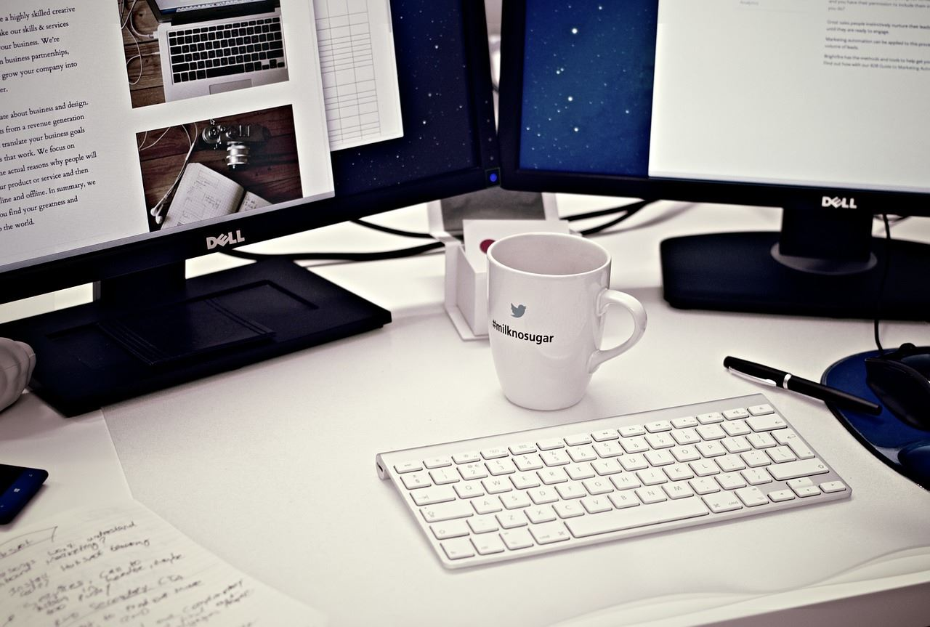

超越自我
This template is exclusively designed by ... creative, and copyrights belong to 1ppt internet.
标题文字添加
标题文字添加
标题文字添加
The user can demonstrate on a projector or computer
The user can demonstrate on a projector or computer
The user can demonstrate on a projector or computer

Slide 7
超越自我
This template is exclusively designed by ... creative, and copyrights belong to 1ppt internet.
标题文字添加
标题文字添加
The user can demonstrate on a projector or computer, or print the presentation and make it into a film to be used in a wider field. Using PowerPoint,
标题文本预设02
The user can demonstrate on a projector or computer, or print the presentation and make it into a film to be used in a wider field. Using PowerPoint,
标题文本预设01
标题文本预设03
标题文字添加
标题文本预设04
标题文字添加
The user can demonstrate on a projector or computer, or print the presentation and make it into a film to be used in a wider field. Using PowerPoint,
The user can demonstrate on a projector or computer, or print the presentation and make it into a film to be used in a wider field. Using PowerPoint,

Slide 8
超越自我
This template is exclusively designed by ... creative, and copyrights belong to 1ppt internet.
标题文字添加
The user can demonstrate on a projector or computer, or presentation and make it film to be used in a wider field
标题文字添加
The user can demonstrate on a projector or computer, or presentation and make it film to be used in a wider field
Title One
81%
Title Two
74%
标题文字添加
Title Three
70%
The user can demonstrate on a projector or computer, or presentation and make it film to be used in a wider field
TEXT HERE
Supporting text here

Slide 9
超越自我
This template is exclusively designed by ... creative, and copyrights belong to 1ppt internet.
工作履历
1/4

Slide 10
超越自我
This template is exclusively designed by ... creative, and copyrights belong to 1ppt internet.
Step 01
Step 02
Step 03
关键词
关键词
关键词
关键词
关键词
关键词
标题文字添加此处
The user can demonstrate on a projector or computer, or print the presentation and make it into a film to be used in a wider fieldThe user can demonstrate on a projector or computer, or print the to be used in a wider field

Slide 11
超越自我
This template is exclusively designed by ... creative, and copyrights belong to 1ppt internet.
标题文字添加
标题文字添加
Far far away, behind the word mountains, far from the countries Vokalia and Consonantia
Far far away, behind the word mountains, far from the countries Vokalia and Consonantia
标题文字添加
标题文字添加
Far far away, behind the word mountains, far from the countries Vokalia and Consonantia
Far far away, behind the word mountains, far from the countries Vokalia and Consonantia

Slide 12

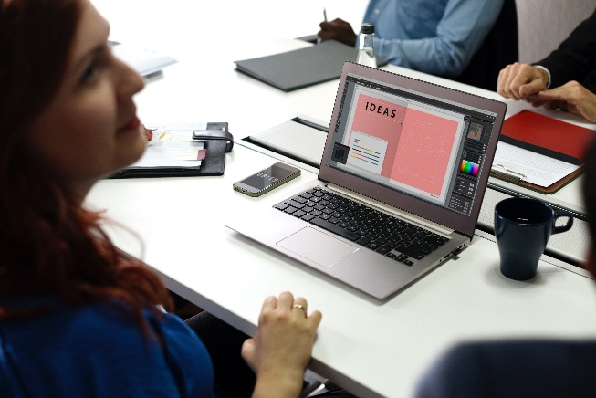


超越自我
This template is exclusively designed by ... creative, and copyrights belong to 1ppt internet.
标题文字添加
标题文字添加
标题文字添加
标题文字添加
The user can demonstrate on a projector or computer, or print the presentation and make it into a film to be used
The user can demonstrate on a projector or computer, or print the presentation and make it into a film to be used
The user can demonstrate on a projector or computer, or print the presentation and make it into a film to be used
The user can demonstrate on a projector or computer, or print the presentation and make it into a film to be used

Slide 13
超越自我
This template is exclusively designed by ... creative, and copyrights belong to 1ppt internet.
标题文字添加
The user can demonstrate on a projector or computer, or print the presentation and make it into a film to be used
标题文字添加
The user can demonstrate on a projector or computer, or print the presentation and make it into a film to be used
标题文字添加
The user can demonstrate on a projector or computer, or print the presentation and make it into a film to be used

Slide 14
超越自我
This template is exclusively designed by ... creative, and copyrights belong to 1ppt internet.
标题文字添加
The user can demonstrate on a projecThe user can demonstrate on a projector or computer, or print the presentation and make it into a film to be usedtor or The user can demonstrate on a projector or computer, or print the presentation and make it into a film to be usedcomputer, or print the presentation and make it into a film to be used

Slide 15
超越自我
This template is exclusively designed by ... creative, and copyrights belong to 1ppt internet.
所获荣誉
1/4

Slide 16


超越自我
This template is exclusively designed by ... creative, and copyrights belong to 1ppt internet.
标题文字添加
标题文字添加
The user can demonstrate on a projector or computer, or print the presentation and make it into a film to be used
The user can demonstrate on a projector or computer, or print the presentation and make it into a film to be used

Slide 17

超越自我
This template is exclusively designed by ... creative, and copyrights belong to 1ppt internet.
标题文字添加
标题文字添加
print the presentation and make it film to be used in a wider field
print the presentation and make it film to be used in a wider field
标题文字添加
标题文字添加
print the presentation and make it film to be used in a wider field
print the presentation and make it film to be used in a wider field

Slide 18


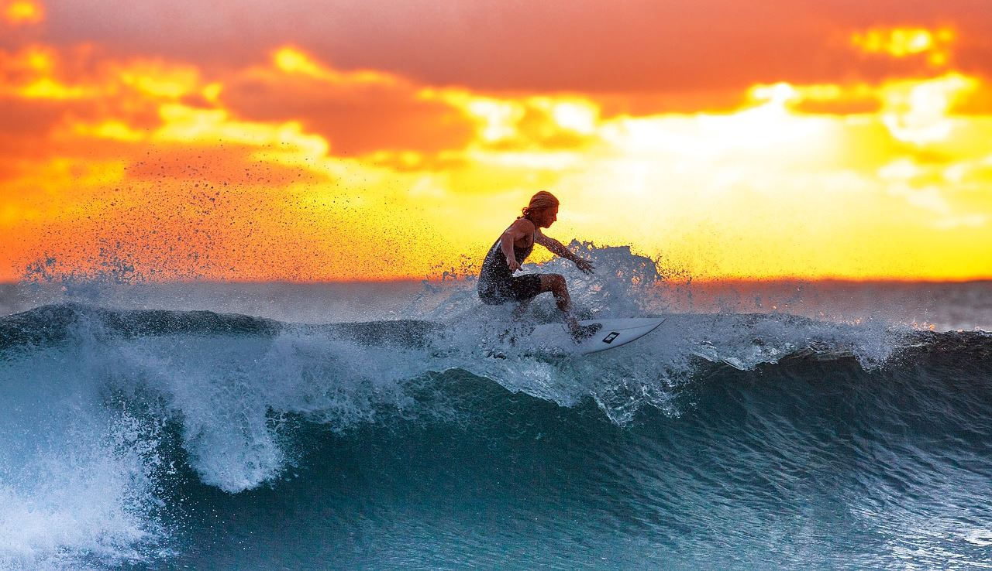
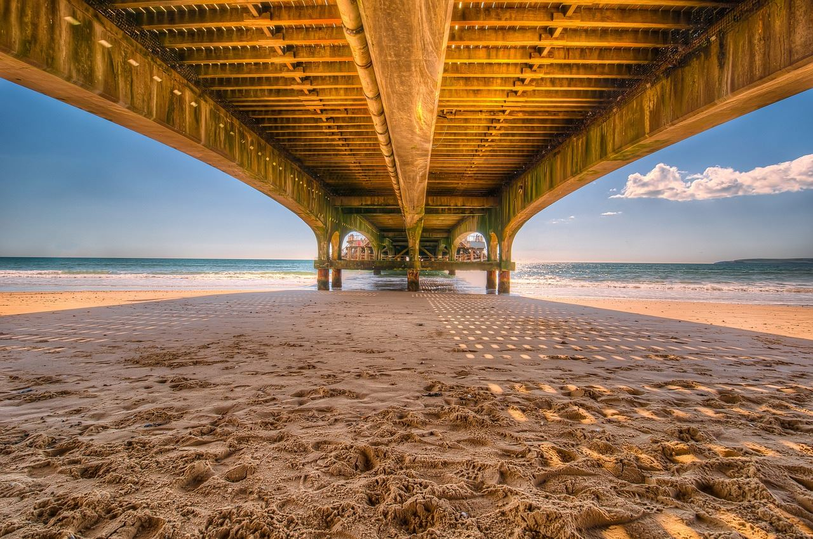
超越自我
This template is exclusively designed by ... creative, and copyrights belong to 1ppt internet.
The user can demonstrate on a projector or computer, or presentation and make it film to be used wider fieldThe user can demonstrate on a projector or computer, or presentation and make it film to be used wider fieldThe user can demonstrate on a projector or computer,
标题文字添加
标题文字添加
标题文字添加
The user can demonstrate on a projector or computer, or presentation and make it film to be used in a wider field
The user can demonstrate on a projector or computer, or presentation and make it film to be used in a wider field
The user can demonstrate on a projector or computer, or presentation and make it film to be used in a wider field

Slide 19
超越自我
This template is exclusively designed by ... creative, and copyrights belong to 1ppt internet.
文字添加
文字添加
文字添加
文字添加
文字添加
文字添加
标题文字添加
The user can demonstrate on a projector or computer, or presentation and make it film to be used in a wider fieldThe user can demonstrate on a projector or computer, or presentation and make it film to be used in a wider field

Slide 20
超越自我
This template is exclusively designed by ... creative, and copyrights belong to 1ppt internet.
规划展望
1/4

Slide 21

超越自我
This template is exclusively designed by ... creative, and copyrights belong to 1ppt internet.
标题文字添加
The user can demonstrate on a projector or computer, or presentation and make it film to be used in a wider field
标题文字添加
The user can demonstrate on a projector or computer, or presentation and make it film to be used in a wider field

Slide 22
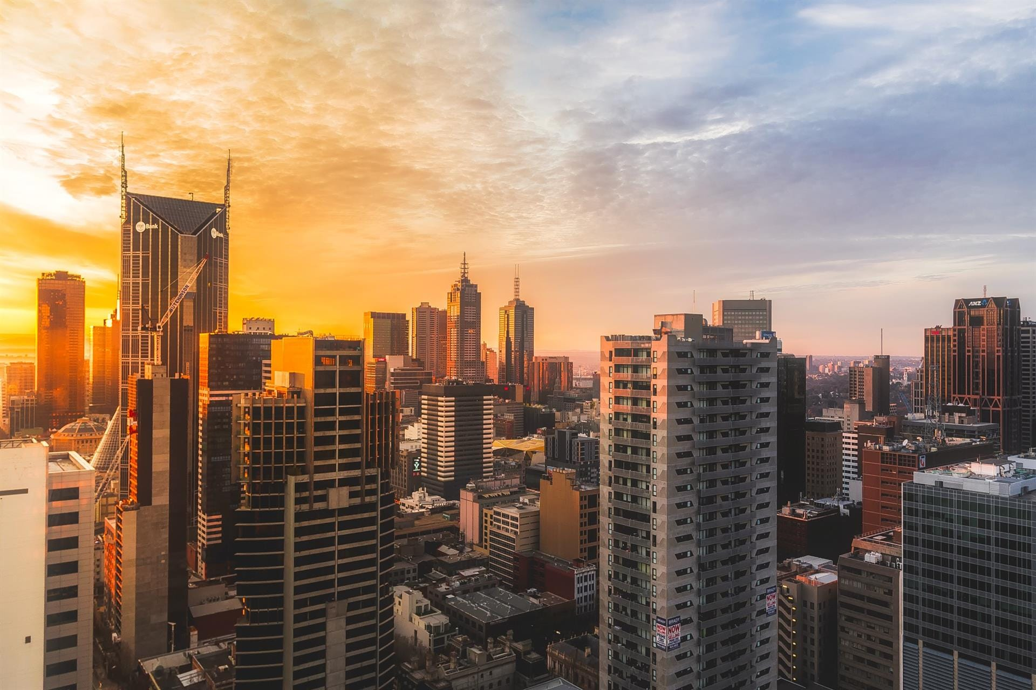
超越自我
This template is exclusively designed by ... creative, and copyrights belong to 1ppt internet.
The user can demonstrate on a projector or computer, or presentation and make it film to be used wider fieldThe user can demonstrate on a projector or computer, or presentation and make it film to be used wider fieldThe user can demonstrate on a projector or computer,
文字添加
文字添加
文字添加
The user can demonstrate on a projector or computer, or presentation and make it film to be used
The user can demonstrate on a projector or computer, or presentation and make it film to be used
The user can demonstrate on a projector or computer, or presentation and make it film to be used

Slide 23
超越自我
This template is exclusively designed by ... creative, and copyrights belong to 1ppt internet.
文字添加
文字添加
文字添加
The user can demonstrate on a projector or computer, or print the presentation
The user can demonstrate on a projector or computer, or print the presentation
The user can demonstrate on a projector or computer, or print the presentation

Slide 24
超越自我
This template is exclusively designed by ... creative, and copyrights belong to 1ppt internet.
标题文字添加
标题文字添加
标题文字添加
标题文字添加
标题文字添加
标题文字添加此处
The user can demonstrate on a projector or computer, or print the presentation and make it into a film to be used in a wider fieldThe user can demonstrate on a projector or computer, or print the to be used in a wider field

Slide 25
超越自我
This template is exclusively designed by ... creative, and copyrights belong to 1ppt internet.
RESUME
感谢观看
姓名：第一PPT
邮箱：12345678@128.com

Slide 26

https://ibaotu.com/ppt/
素材授权/素材来源@包图网
本素材仅供学习研究使用。禁止商用、传播、转载。

Slide 27

可以在下列情况使用
个人学习、研究。
拷贝模板中的内容用于其它幻灯片母版中使用。
不可以在以下情况使用
任何形式的在线付费下载。
网络转载、线上线下传播。
PPT模板： www.1ppt.com/moban/ 行业PPT模板：www.1ppt.com/hangye/
节日PPT模板：www.1ppt.com/jieri/ PPT素材： www.1ppt.com/sucai/
PPT背景图片：www.1ppt.com/beijing/ PPT图表： www.1ppt.com/tubiao/
优秀PPT下载：www.1ppt.com/xiazai/ PPT教程： www.1ppt.com/powerpoint/
Word模板： www.1ppt.com/word/ Excel模板： www.1ppt.com/excel/
个人简历： www.1ppt.com/jianli/ PPT课件： www.1ppt.com/kejian/
手抄报： www.1ppt.com/shouchaobao/ 试题下载： www.1ppt.com/shiti/
教案下载： www.1ppt.com/jiaoan/ 字体下载： www.1ppt.com/ziti/

